Slide 1

MEMBERSHIP WEB SYSTEM
Integration Procedure and Protocol

Slide 2


SYSTEM FLOW
Scan & pay
exchange
transfer
retrieve
exchange
POS Counter
System
Data
Network
KSC Database
Panda Server

Slide 3
API MODULE
Source System
Field Name | Max Length | Data Type | Method
Id | 100 | int | “POST”
Point | 100 | int | “POST”
receive
Target System
Panda System
Field Name | Data Type | Max Length | Method
Id | int | 100 | “POST”
Point | int | 100 | “POST”
revert

Slide 4
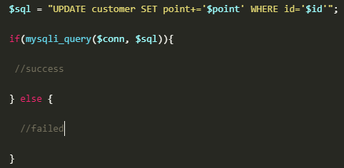

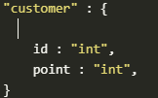
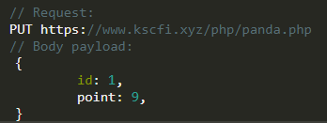
BACKEND SYSTEM
Language : php & html
Procedure : update point
Update Database :
Create Connection :
Create Database :
API SAMPLE
Notes:
// Request:
PUT https://www.kscfi.xyz/php/panda.php
// Body payload:
{
id: 1,
point: 9,
}

Slide 5
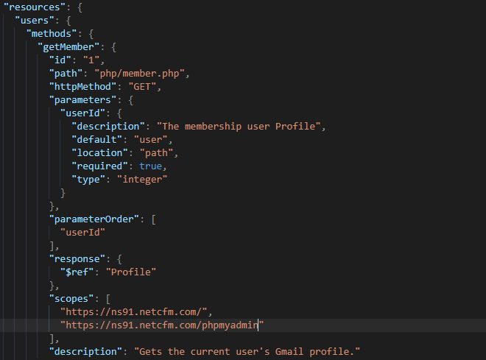
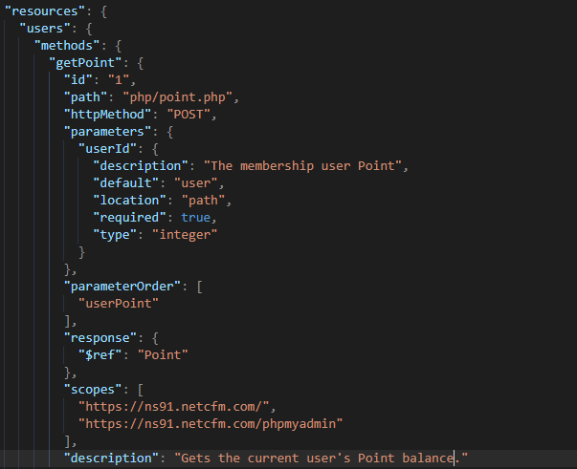
API
To get the member Id
To get the member Point
UserId | The user id in the store
User | Customer name
Point | Amount membership point
UserId | User Id own a account.

Slide 6
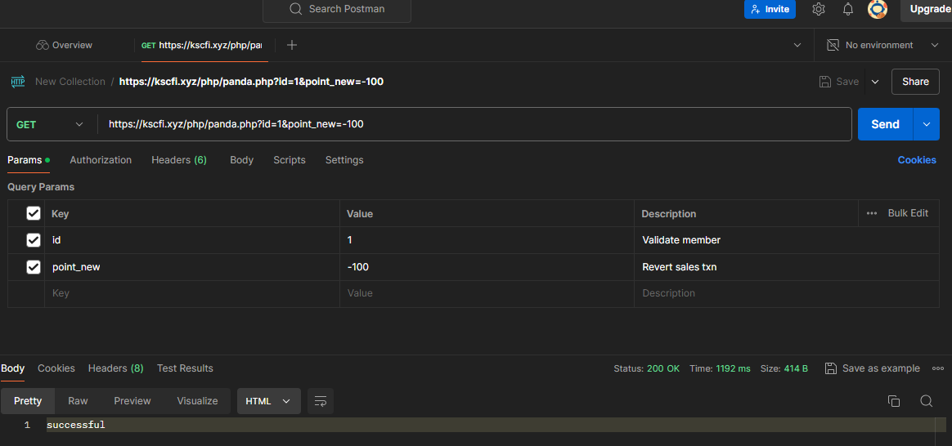
API

Slide 7
RESOURCE
KOM.CC : Web Hosting
Direct Admin : API Platform
phpMyAdmin : Database
End point: https://ns91.netcfm.com

